Slide 1
REAL MODE MEMORY ADDRESSING
The 80286 and above operate in either the real or protected mode.
Only the 8086 and 8088 operate exclusively in the real mode. In the 64-bit operation mode of the Pentium 4 and Core2, there is no real mode operation.
Real mode operationallows the microprocessor to address only the first 1M byte of memory space—even if it is the Pentium 4 or Core2 microprocessor. Note that the first 1M byte of memory is called the real memory,conventional memory, or DOS memorysystem

Slide 2
Segments and Offsets
A combination of a segment address and an offset address accesses a memory location in the real mode.
All real mode memory addresses must consist of a segment address plus an offset address. The segment address, located within one of the segment registers, defines the beginning address of any 64K-byte memory segment.
The offset address selects any location within the 64K byte memory segment. Segments in the real mode always have a length of 64K bytes.

Slide 3
Figure 2–3 shows how the segment plus offset addressing scheme selects a memory location.
This illustration shows a memory segment that begins at location 10000H and ends at location IFFFFH—64K bytes in length.
It also shows how an offset address, sometimes called a displacement, of F000H selects location 1F000H in the memory system.
Note that the offset or displacement is the distance above the start of the segment, as shown in Figure 2–3

Slide 4
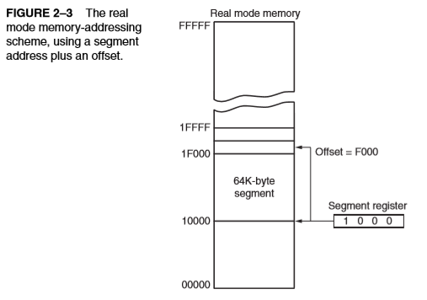

Slide 5
In the real mode, each segment register is internally appended with a 0H on its rightmost end. This forms a 20-bit memory address, allowing it to access the start of a segment.
The microprocessor must generate a 20-bit memory address to access a location within the first 1M of memory. For example, when a segment register contains 1200H, it addresses a 64K-byte memory segment beginning at location 12000H

Slide 6
Default Segment and Offset Registers
The microprocessor has a set of rules that apply to segments whenever memory is addressed.
These rules, which apply in the real and protected mode, define the segment register and offset register combination.
For example, the code segment register is always used with the instruction pointer to address the next instruction in a program. This combination is CS:IP or CS:EIP, depending upon the microprocessor’s mode of operation.
The code segment register defines the start of the code segment and the instruction pointer locates the next instruction within the code segment. This combination (CS:IP or CS:EIP) locates the next instruction executed by the microprocessor.
For example, if and , the microprocessor fetches its next instruction from memory location or 15200H.

Slide 7
Another of the default combinations is the stack. Stack data are referenced through the stack segment at the memory location addressed by either the stack pointer (SP/ESP) or the pointer (BP/EBP).
Other defaults are shown in Table 2–3 for addressing memory using any Intel microprocessor with 16-bit registers.
Table 2–4 shows the defaults assumed in the 80386 and above using 32-bit registers.

Slide 8
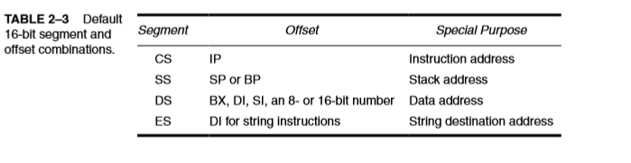
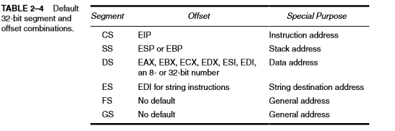

Slide 9
INTRODUCTION TO PROTECTED MODE MEMORY ADDRESSING
Protected mode memory addressing (80286 and above) allows access to data and programs located above the first 1M byte of memory, as well as within the first 1M byte of memory.
Protected mode is where Windows operates.
Addressing this extended section of the memory system requires a change to the segment plus an offset addressing scheme used with real mode memory addressing.

Slide 10
When data and programs are addressed in extended memory, the offset address is still used to access information located within the memory segment.
One difference is that the segment address, as discussed with real mode memory addressing, is no longer present in the protected mode.
In place of the segment address, the segment register contains a selector that selects a descriptor from a descriptor table
The descriptor describes the memory segment’s location, length, and access rights.
Because the segment register and offset address still access memory, protected mode instructions are identical to real mode instructions.
In fact, most programs written to function in the real mode will function without change in the protected mode. 4.

Slide 11
The difference between modes is in the way that the
segment register is interpreted by the microprocessor to access the memory segment.
Another difference, in the 80386 and above, is that the offset address can be a 32-bit number instead of a 16-bit number in the protected mode.
A 32-bit offset address allows the microprocessor to access data within a segment that can be up to 4G bytes in length.
Programs that are written for the 32-bit protected mode execute in the 64-bit mode of the Pentium

Slide 12
Selectors and Descriptors
The selector, located in the segment register, selects one of 8192 descriptors from one of two e entire system for the code segment, as explained shortly.
There are two descriptor tables used with the segment registers: one contains global descriptors and the other contains local descriptors.
The global descriptors contain segment definitions that apply to all programs,
whereas the local descriptors are usually unique to an application.
You might call a global descriptor a system descriptor and call a local descriptor an application descriptor tables of descriptors

Slide 13
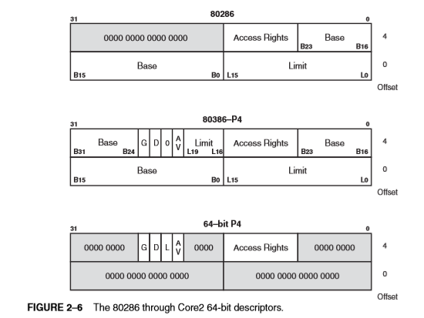

Slide 14
The base address portion of the descriptor indicates the starting location of the memory segment. For the 80286 microprocessor, the base address is a 24-bit address, so segments begin at any location in its 16M bytes of memory.
The 80386 and above use a 32-bit base address that allows segments to begin at any location in its 4G bytes of memory
The segment limit contains the last offset address found in a segment. For example, if a segment begins at memory location F00000H and ends at location F000FFH, the base address is F00000H and the limit is FFH

Slide 15
There is another feature found in the 80386 through the Pentium 4 descriptor that is not found in the 80286 descriptor: the G bit, or granularity bit.
If ,G=0 the limit specifies a segment limit of 00000H to FFFFFH.
If , G=1 the value of the limit is multiplied by 4K bytes (appended with FFFH).
The limit is then 00000FFFFH to FFFFFFFFH,
if G=1. This allows a segment length of 4K to 4G bytes in steps of 4K bytes.
The reason that the segment length is 64K bytes in the 80286 is that the offset address is always 16 bits because of its 16-bit internal architecture.
The 80386 and above use a 32-bit architecture that allows an offset address, in the protected mode operation, of the 32 bits. This 32-bit offset address allows segment lengths of 4G bytes and the 16-bit offset address allows segment lengths of 64K bytes. Operating systems operate in a 16- or 32-bit environment.

Slide 16
In the 64-bit descriptor, the L bit (probably means large, but Intel calls it the 64-bit) selects 64-bit addresses in a Pentium 4 or Core2 with 64-bit extensions when L =1and 32-bit compatibility mode when L =0.
The AV bit, in the 80386 and above descriptor, is used by some operating systems to indicate that the segment is available ( AV=1) or not available ( AV =0) .

Slide 17
The D bit indicates how the 80386 through the Core2 instructions access register and memory data in the protected or real mode.
If D=0 , the instructions are 16-bit instructions, compatible with the 8086–80286 microprocessors. This means that the instructions use 16-bit offset addresses and 16-bit register by default. This mode is often called the 16-bit instruction mode or DOS mode.
If D=1, the instructions are 32-bit instructions. By default, the 32-bit instruction mode assumes that all offset addresses and all registers are 32 bits.

Slide 18
FLAT MODE MEMORY
The memory system in a Pentium-based computer (Pentium 4 or Core2) that uses the 64-bit extensions uses a flat mode memory system.
A flat mode memory system is one in which there is no segmentation.
The address of the first byte in the memory is at 00 0000 0000H and the last location is at FF FFFF FFFFH (address is 40-bits).
The flat model does not use a segment register to address a location in the memory.
The CS segment register is used to select a descriptor from the descriptor table that defines the access rights of only a code segment.

Slide 19
The segment register still selects the privilege level of the software.
The flat model does not select the memory address of a segment using the base and limit in the descriptor (see Figure 2–6).
In 64-bit mode the actual address is not modified by the descriptor as in 32-bit protected mode.
The offset address is the actual physical address in 64-bit mode. Refer to Figure 2–15 for the flat mode memory model.

Slide 20
